Slide 1
Abstract factory
Presenter: Chu Quoc Hung

Slide 2
Purpose
Have basic understanding of Abstract Factory
Know when to use Abstract Factory pattern
Recognize the benefit and tradeoff of applying Abstract Factory

Slide 3
outline
Name and Classification
Applicability
Structure, Participants and Collaborations
Consequences

Slide 4
Name and Classification
Name: Abstract Factory
Also known as: Kit
Classification: Creational Pattern

Slide 5
Applicability
Abstract Factory should be used when:
A system should be independent of how its products are created, composed, and represented
A system should be configured with one of multiple families of products
A family of related product objects is designed to be used together, and you need to enforce this constraint
You want to provide a class library of products, and you want to reveal just their interfaces, not their implementations

Slide 6
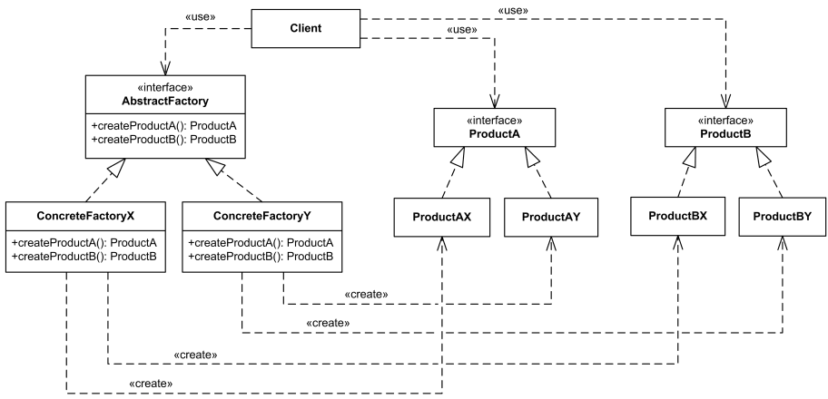
Structure, Participants and Collaborations Structure

Slide 7
Structure, Participants and Collaborations Participants
AbstractFactory: declares an interface for creating abstract product objects
ConcreteFactory: implements the objects creation operations
AbstractProduct: declares an interface for a type of product object
ConcreteProduct: defines a product object to be created by the corresponding concrete factory, implements the AbstractProduct interface
Client: uses AbstractFactory and AbstractProduct interfaces

Slide 8
Structure, Participants and Collaborations Collaborations
A single instance of a ConcreteFactory class is created at run-time
To create different product objects, clients should use a different concrete factory
AbstractFactory defers creation of product objects to its ConcreteFactory subclass

Slide 9
Consequences
Benefit
- Isolates concrete classes
- Makes exchanging product families easy
- Increase consistency among products
Drawback: Supporting new kinds of products is difficult

Slide 10
Thank you for your attention !

